Slide 1
Which Boston College/University to start my career as a Data Scientist?
by Tyler Lareau

Slide 2
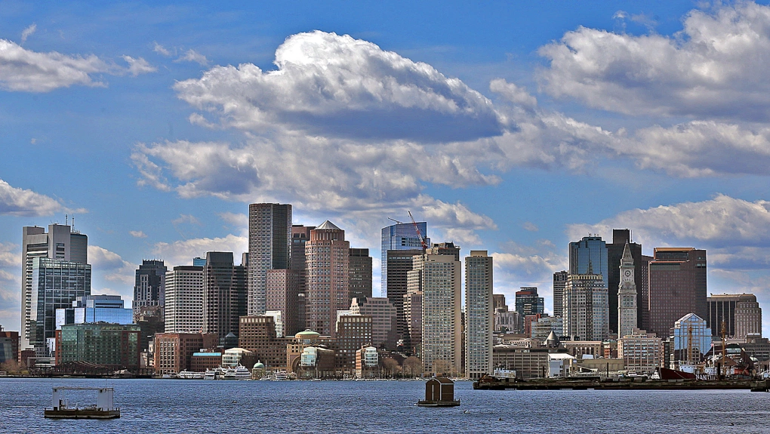
Business Problem
Business Problem
Which college or university in the Greater Boston do I want to work for?
I am going to leverage the power of public datasets and location data to select a school which I think will best fit my new career as a data scientist.

Slide 3
School Must
-be located in the Greater Boston Area
- have over 5000 students. As a data scientist, I am going to want to intake as much data as possible and believe that 5000 is a solid minimum to retrieve valuable and diverse data.
-Sports Complexes/Arenas must be popular venues within the 500M radius of campus. Sports is one of the industries with high demands for data scientists and I want to be in walking distance of the school’s sports complexes
-School must have access to public transportation in the immediate radius (500M)

Slide 4
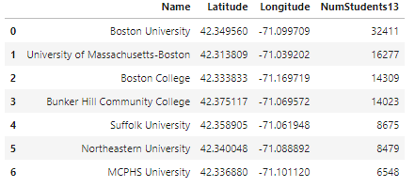
Boston Schools with 5000+ Students

Slide 5
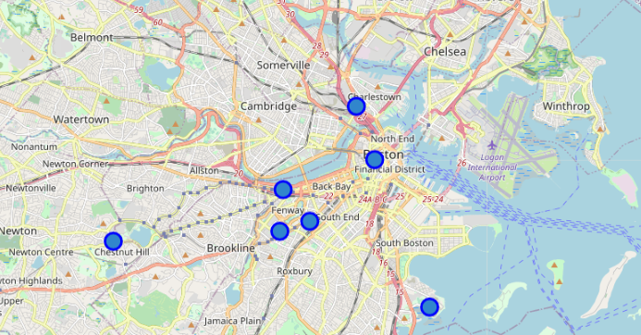
Boston Schools with 5000+ Students Coordinates

Slide 6
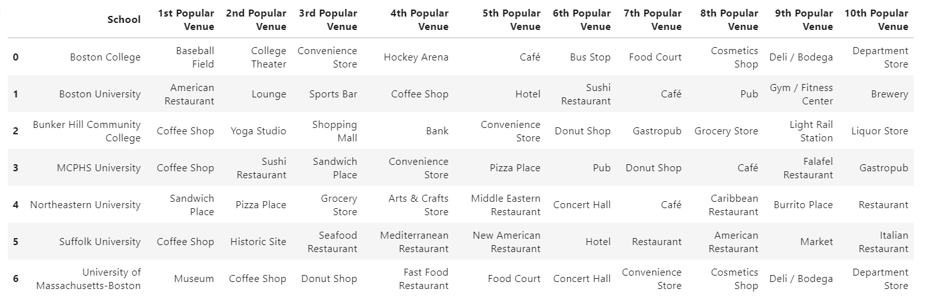
Most Frequently Checked-In Places within 500M of each college

Slide 7
Results
I will apply to become a data scientist at…..

Slide 8
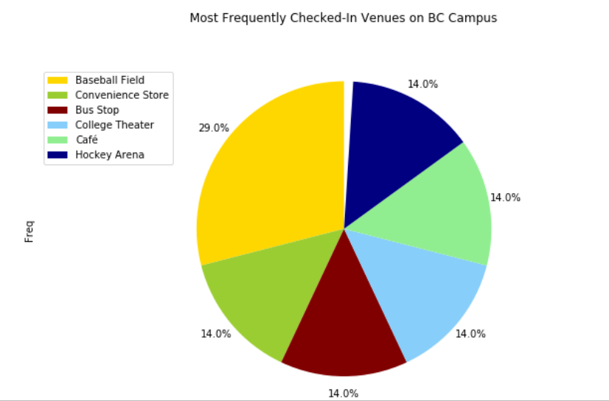
Boston College
- 3 venues in the Top 10 Most Frequently Checked in Places
-Baseball Field
-Hockey Arena
-Bus Stop

